Slide 1
How Machine Learning Is Changing Healthcare
Deep learning models now detect cancer earlier than radiologists
01

Slide 2

Why Healthcare Needs ML Now
US healthcare spending hit $4.5 trillion with diminishing outcomes
Clinical data doubles every 73 days overwhelming human review
Physician burnout reaches 63% driven by documentation burden
Legacy rule engines fail to capture multimodal patient complexity
ML transforms reactive sick-care into proactive health optimization
02

Slide 3
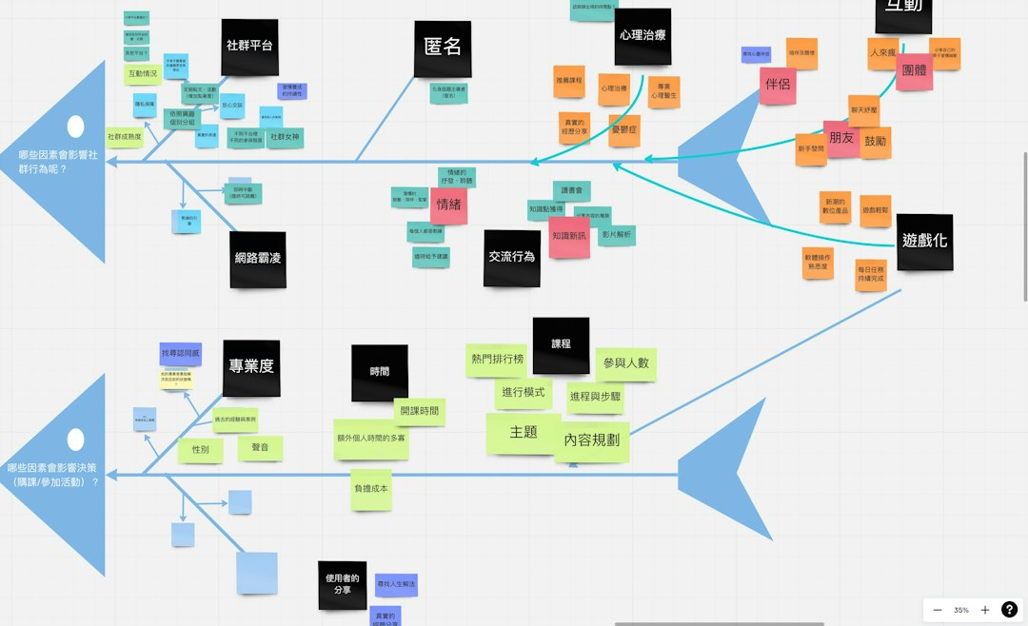
Traditional vs. ML-Driven Workflows
Rule-based CDS triggers alerts on hardcoded thresholds only
ML models ingest continuous streams: vitals, notes, wearables
Static protocols ignore patient trajectory and comorbidity interactions
Adaptive models update weights from deployment feedback loops
Human-in-the-loop design preserves clinician autonomy and trust
03

Slide 4
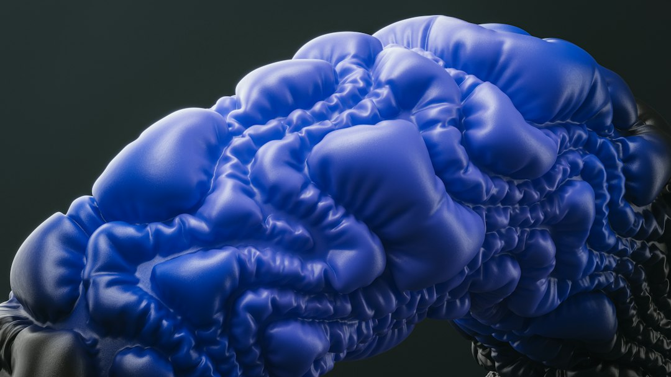
Core Applications: Imaging, Genomics, Ops
CNNs achieve radiologist-level AUC on chest X-ray triage
Transformer architectures predict therapy response from RNA-seq
RL agents reduce OR scheduling delays by 27% in trials
Graph neural networks model drug-protein interactions at scale
Edge deployment brings inference to portable ultrasound devices
04

Slide 5
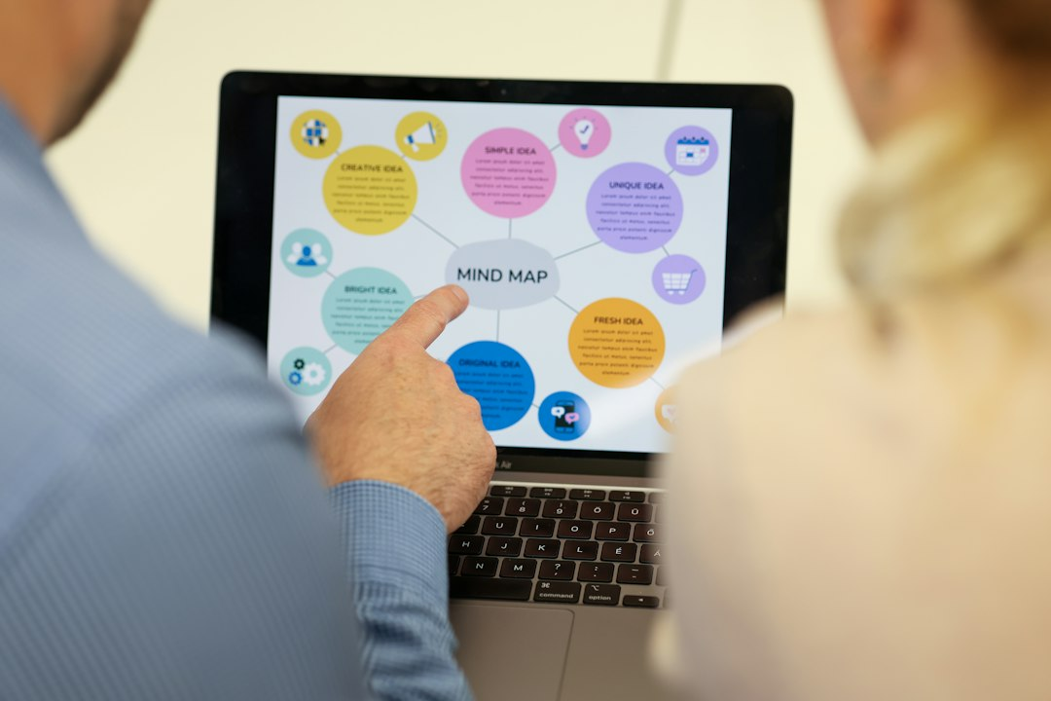
Measurable Impact By The Numbers
Production deployments show consistent double-digit gains
Radiology AI reduces missed nodules by 47% in screening
Hospital-at-home programs cut costs 38% with ML triage
Model monitoring catches drift before clinical harm occurs
47% fewer missed nodules
38% lower episode spend
31% less documentation
Diagnostic accuracy improvement
Cost reduction in acute care
Clinician time savings
05

Slide 6
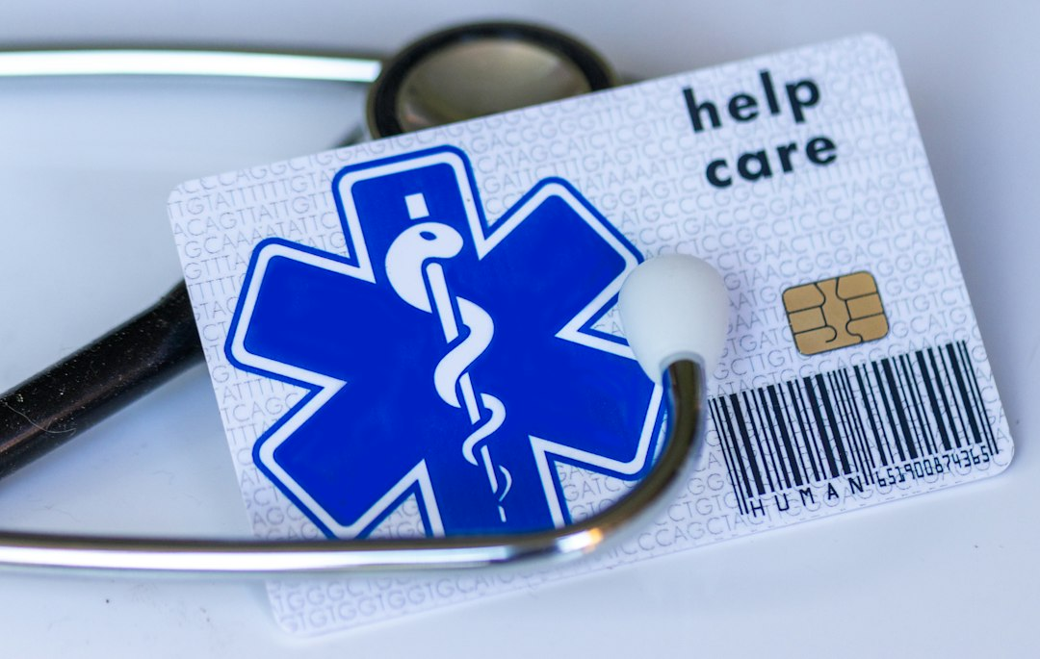
Real-World Challenges: Data, Bias, Regulation
FHIR APIs still leave 60% of clinical notes in unstructured text
Training data underrepresents minorities causing 15% AUC gaps
FDA SaMD pathway requires locked algorithms vs continuous learning
Model cards and datasheets become mandatory for audit trails
Explainability requirements differ across clinical specialties
06

Slide 7
“
The model that saves lives isn't the one with the highest AUC — it's the one the night-shift nurse trusts enough to act on at 3 AM.
— Dr. Priya Natarajan, MD/PhD — Clinical AI Lead, Academic Medical Center
07

Slide 8
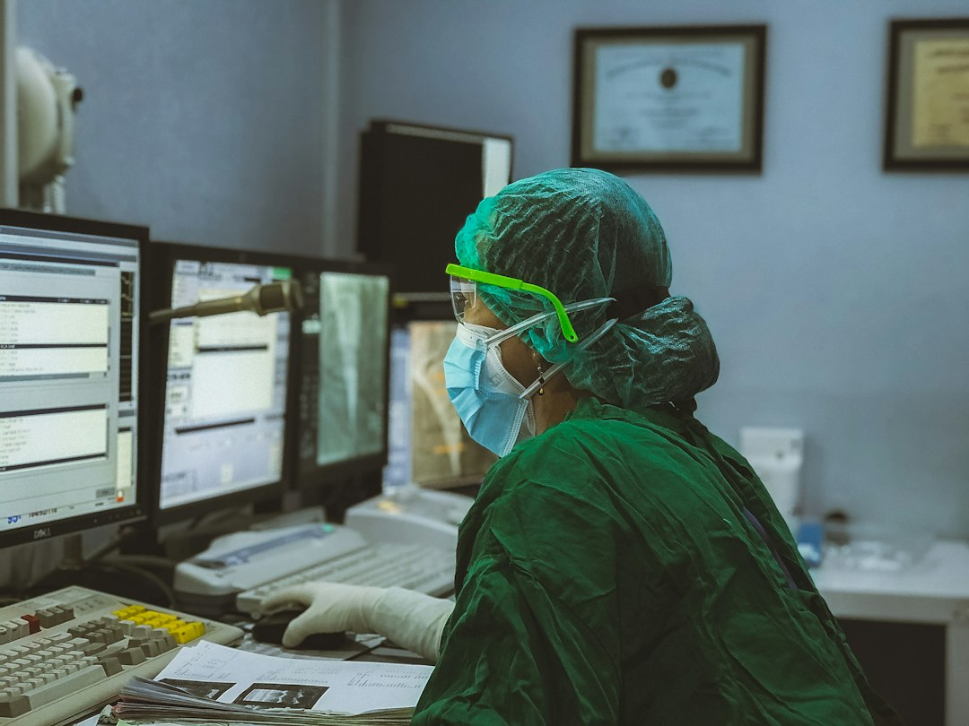
Getting Started: Your ML Healthcare Stack
Build on FHIR-native data lakes with de-identification pipelines
Adopt MLflow + Great Expectations for reproducible model lineage
Implement Predetermined Change Control Plans for FDA readiness
Design human-in-the-loop UIs with clinician co-design sprints
Establish model monitoring: drift, fairness, clinical outcome tracking
08

